Slide 1


OpsReplay
Google Cloud Next, April 2026
75%
New Code at Google Generated with AI
When something goes wrong, can an agent find the fault all the time?
Notes:
Speaker 1 | 0:00 to 0:35 | 35 seconds
Think of the last change an AI agent wrote for you. Who decided it was safe to ship? In April, Google reported that AI generated three quarters of its new code and engineers approved it. Now imagine the change goes live. The shop still loads, but nobody can place an order. Where would you look first?
Google Cloud Next, April 2026 (https://blog.google/innovation-and-ai/infrastructure-and-cloud/google-cloud/cloud-next-2026-sundar-pichai/)

Slide 2
OpsReplay
Keeping an evolving codebase working
Fewer than 1 in 4
100 maintenance tasks
Each came from a repository history averaging 233 days and 71 consecutive commits.
For most models tested, this was the share of tasks that stayed free of regressions through every round of changes.
SWE-CI · Alibaba Group and Sun Yat-sen University · April 2026
Notes:
Speaker 1 | 0:35 to 1:15 | 40 seconds
Researchers at Alibaba and Sun Yat-sen University tested agents on 100 maintenance tasks drawn from real repositories. For most models, fewer than one in four tasks stayed free of regressions through every round of changes. A regression means a test that used to pass now fails. It’s the question behind every proposed fix: what else relied on the behaviour we just changed?
Chen et al., SWE-CI, §4.3, April 2026 (https://arxiv.org/html/2603.03823v4). The authors evaluated 20 models. Two exceeded a 50% zero-regression rate.

Slide 3


OpsReplay
When an agent has to find the fault
47%
The page loads. Orders fail. Which service would you check first?
Best AI score on incident diagnosis
59
incident tasks
ITBench-AA, May 2026
Notes:
Speaker 1 | 1:15 to 1:55 | 40 seconds
Finding the fault is a separate challenge. IBM and Artificial Analysis gave agents snapshots of 59 reliability incidents. At launch, the best diagnosis score was 47%. To score well, an agent had to identify all the responsible components without adding wrong guesses. An engineer still has to decide which signal to trust and whether a repair will actually let customers buy again.
IBM and Artificial Analysis, ITBench-AA, May 2026 (https://huggingface.co/blog/ibm-research/itbench-aa). The metric is average precision at full recall.

Slide 4


Who needs incident practice?
Computing students
Junior Software Engineers
Site Reliability Engineers
A first chance to troubleshoot a failing service before graduation
A rehearsal for the first time they carry the on-call phone
Additional practice for first responders. What to first check for when something goes wrong.
Notes:
Speaker 1 | 1:55 to 2:30 | 35 seconds
Our first users are computing students and junior engineers preparing for their first on-call shift. Reliability engineers can also rehearse unfamiliar incidents. A systems instructor gives us a way to reach a whole cohort at the moment this skill matters. The next question is what we want learners to get better at.
OpsReplay product requirements, Audience and P01.

Slide 5


OpsReplay
How developers build a mental model
In 17 debugging tasks, developers revised their picture of the system as they traced code and ran it.
What that sounds like at checkout
“The page loaded. Did the order reach the next service? Which log would tell me?”
Li and Coblenz · 12 developers working in their own codebases · FSE 2026
Notes:
Speaker 2 | 2:30 to 3:02 | 32 seconds
Think of a mental model as your working picture of how a request moves through a system. Li and Coblenz watched 12 developers tackle 17 debugging tasks. Developers revised that picture as they traced code and ran it. At checkout, the question becomes concrete. Did the order reach the next service, and what evidence would tell us?
Li and Coblenz, A Grounded Theory of Debugging in Professional Software Engineering Practice (https://arxiv.org/abs/2602.11435). Qualitative observation of seven professional developers and five professional live-coding streamers. The study did not test a training intervention.

Slide 6
OpsReplay
What incident practice can teach
62%
83%
Mean test score before training
Mean test score after training
In a cybersecurity exercise, 50 students scored higher on the post-test. OpsReplay applies the idea of hands-on practice to service outages.
Glas, Vielberth and Pernul · University of Regensburg · CHI 2023
Notes:
Speaker 2 | 3:02 to 3:35 | 33 seconds
In a cybersecurity exercise with 50 students, mean test scores rose from 62% before training to 83% afterwards. The scores were specific to that exercise. For OpsReplay, the design idea is straightforward: give the learner a failure, let them choose a first check, and let them see what happened. Here’s how a Challenge puts that into practice.
Glas, Vielberth and Pernul, Train as you Fight, CHI 2023 (https://epub.uni-regensburg.de/54029/1/3544548.3581046.pdf). The study measured scores immediately before and after a cybersecurity exercise.

Slide 7
OpsReplay
Inside an OpsReplay Challenge
Investigate
Repair
Replay
Work from the symptoms in a private lab running real services.
Make a change and check whether customers can place an order.
Revisit the evidence, then try a different approach in a fresh lab.
Notes:
Speaker 2 | 3:02 to 3:37 | 35 seconds
OpsReplay starts with a customer-visible symptom in a private lab running real services. The learner chooses what to inspect, makes a repair and checks whether checkout works again. Then they can replay their decisions alongside the service signals or try a different approach in a fresh lab.
OpsReplay product requirements, P04 to P11.

Slide 8
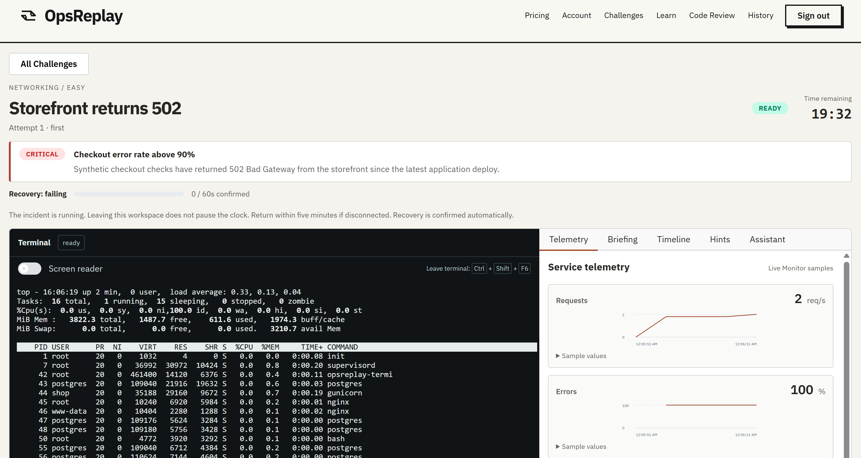
OpsReplay
Why did checkout fail?
Challenge workspace screenshot
Use the terminal and service signals to choose the first check.
Notes:
Speaker 2 | 3:37 to 4:04 | 27 seconds
Presenter cue: Show the real Challenge workspace screenshot. Point to the symptom and one piece of visible evidence.
This is the learner’s starting point. The page loads, but an order fails. The terminal and service signals give the learner a way to narrow down where the request stopped before they change anything.

Slide 9
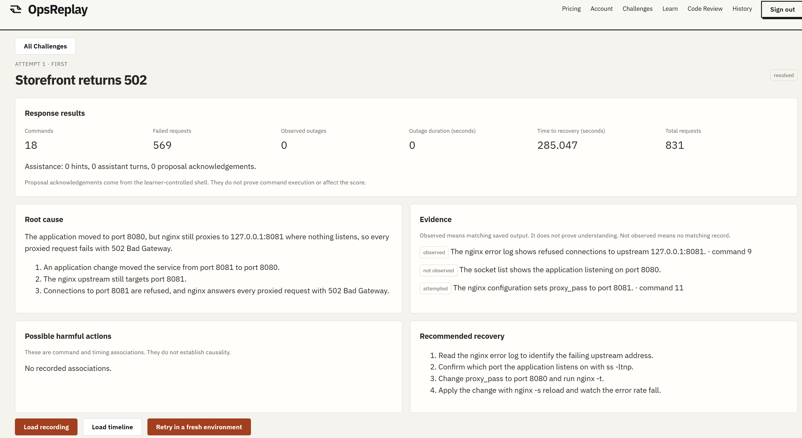
OpsReplay
Did the fix work?
Review the outcome, then replay what happened around the repair.
Notes:
Speaker 2 | 4:04 to 4:27 | 23 seconds
Presenter cue: Show the real debrief or playback screenshot. Point to the observed outcome, then hand over to the demo speaker.
This is what the learner can revisit afterwards. The debrief records the outcome, and playback lets them compare a decision with what the service did around that time. Let’s follow one attempt in the demo.

Slide 10
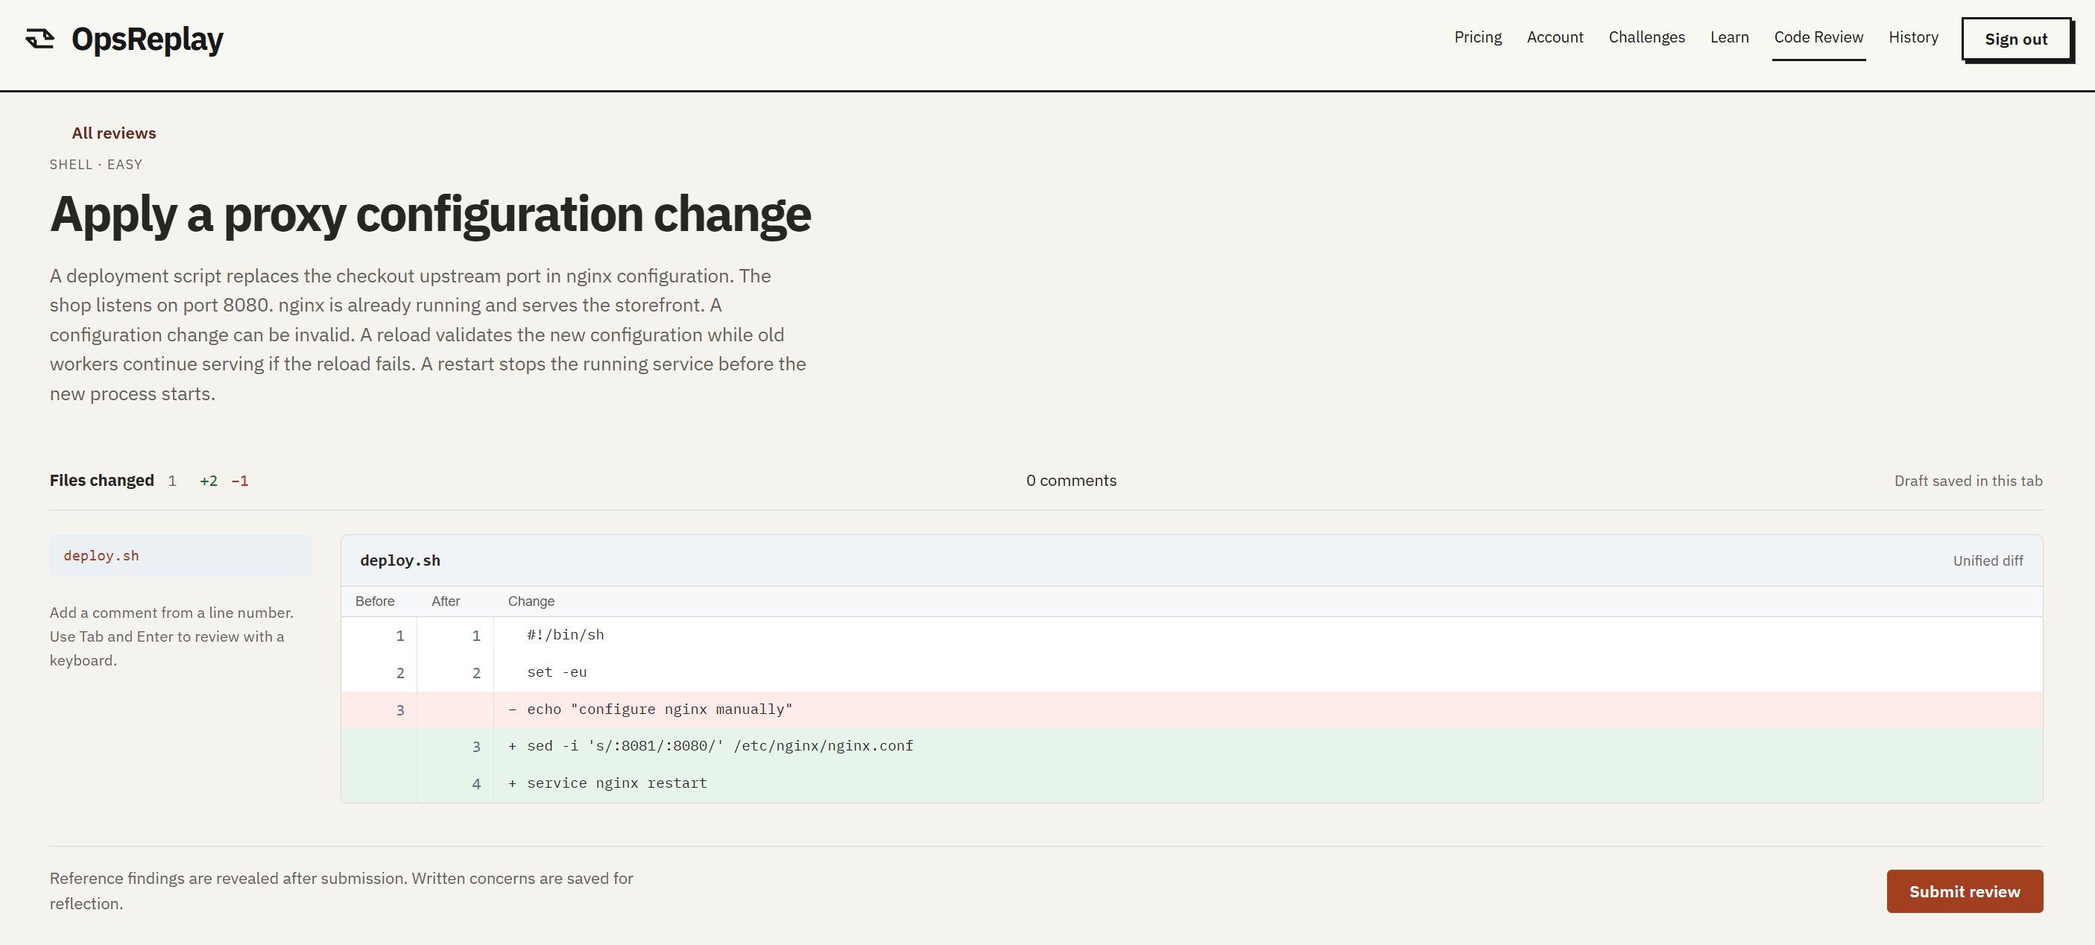
OpsReplay
Code Review Challenges
Practise reviewing configuration changes
Notes:
Speaker 2
An additional feature of OpsReplay is practices for reviewing configuratrion changes. This allows learners to spot mistakes in code reviews before they get shipped to production and cause an incident.

Slide 11
Demo
Notes:
Speaker 3 | 5:00 to 7:30 | 150 seconds
Before the talk, cue a real recorded run or prepare a working lab at the start of the incident. Use the actual observations and outcome from that run. The times below are elapsed demo time.
0:00 to 0:20 | Show the symptom
Open the prepared learner workspace or a recording of an actual run. Show the checkout symptom visible in that attempt.
Here’s the customer problem. I’ll follow this attempt from the first sign of failure to the check that tells us whether checkout recovered.
0:20 to 0:55 | Choose a first check
Point to one service signal and one relevant terminal observation. Describe exactly what they show.
I want to find where the request stopped. This is the clue I’d use to choose which service to inspect next.
0:55 to 1:40 | Follow the repair
Show the recorded investigation and change, or perform the rehearsed repair in the prepared lab. Explain the reason for that action.
Before I make a change, I want a way to tell if it helped. The question I’ll come back to is whether a customer can place an order.
1:40 to 2:15 | Check the result
Show the actual recovery check and debrief. Say whether the observed attempt recovered, and point to the evidence for that outcome.
Here’s what the customer-facing check recorded. This is how I would decide whether to keep investigating.
2:15 to 2:30 | Replay and hand off
Highlight one decision on the timeline, then return to the deck.
That’s the decision I’d revisit. In an interview, I can now show exactly why I made it.

Slide 12
OpsReplay
Competitive advantage
Two repairs can restore checkout.
How many orders failed along the way?
OpsReplay measures failed requests and time to recovery. Learners can explain the customer impact of the path they took.
Notes:
Speaker 4 | 7:30 to 8:20 | 50 seconds
You just saw checkout recover. Now imagine two candidates who both got it working. One restored service quickly. The other restarted a healthy service first and more orders failed while they investigated. A final success indicator looks the same for both. OpsReplay records failed requests and time to recovery. A candidate can use those observations to explain what their approach cost customers and what they would check earlier the next time.
OpsReplay product requirements P05 to P10. The two-candidate example illustrates the product and describes no measured learner outcomes.

Slide 13
OpsReplay
Where OpsReplay fits
SadServers
Live troubleshooting scenarios, progressive hints and solution checks.
KodeKloud
DevOps tasks in live labs, with automated validation and repeat attempts.
OpsReplay
Review customer impact, align terminal actions with service signals, then retry with the first result preserved.
Sources · SadServers labs and KodeKloud 100 Days of DevOps
Notes:
Speaker 4 | 8:20 to 9:10 | 50 seconds
SadServers has live troubleshooting, progressive clues and a solution check. KodeKloud offers validated DevOps tasks and repeat attempts. Those are established reasons to use either platform. Our specific offer is for an engineer who needs to explain an incident afterwards. They can inspect customer impact, revisit the signals available when they made a choice, and try a different recovery while keeping the first result. That combination gives them concrete material for an interview answer.
SadServers FAQ (https://sadservers.com/faq) and KodeKloud 100 Days of DevOps (https://kodekloud.com/100-days-of-devops). OpsReplay product requirements P05 to P10. Comparison uses documented workflows.

Slide 14
OpsReplay
What replay adds
Replay
A fresh second attempt
Keep the first result, change one decision, and compare failed requests and recovery time.
Commands, logs and metrics share one timeline.
OpsReplay Challenge debrief, playback and retry
Notes:
Speaker 4 | 9:10 to 10:00 | 50 seconds
Replay earns its place when the learner can answer a question about timing. Did the errors start before I ran that command? Had requests already begun to recover when I changed the configuration? The command, logs and service metrics share a timeline, so the learner can inspect their sequence. A retry starts fresh and keeps the original debrief. That lets someone try an earlier check and see how the two attempts differ. A free first incident includes that whole experience. Here’s what students could pay for next.
OpsReplay product requirements P09 and P10. Events that occur close together in a recording do not establish causation.

Slide 15
OpsReplay
A free first incident
Free
Pro
Institutional
Introductory content, full debrief, playback and fresh retries.
S$11.99/month placeholder for more published exercises and longer lab sessions.
Future per-seat access for courses and training cohorts.
Notes:
Speaker 5 | 10:00 to 10:30 | 30 seconds
A free learner can investigate an incident, review the debrief, replay the timeline and retry. We’re using S$11.99 per month as the placeholder Pro price for more exercises and longer sessions. We haven’t collected payments. Our model starts with an acquisition assumption: how many new learners might try that first incident each week?
S$11.99 is the pitch pricing assumption. Product scope includes free playback, retry and a future per-seat institutional offer.

Slide 16
OpsReplay
How many learners
could we reach?
1,625
Assume 25 new direct users a week. Across 52 weeks that gives 1,300 direct sign-ups, before word of mouth.
estimated first-year sign-ups
325
new sign-ups
from referrals
Scenario · One referral per four direct users
Notes:
Speaker 5 | 10:30 to 11:10 | 40 seconds
Start with 25 new direct users per week. Over 52 weeks, that gives 1,300 distinct sign-ups. We keep word of mouth simple: assume each group of four direct users brings in one new classmate who signs up. That adds 325 referrals, for 1,625 first-year users. Each referred user counts once, and we stop at the first referral. These are acquisition assumptions we would track against actual sign-ups.
Direct sign-ups = 25 × 52 = 1,300. First-generation referral sign-ups = 1,300 ÷ 4 = 325. Total = 1,625. The 25 weekly direct sign-ups exclude referrals.

Slide 17
OpsReplay
What those sign-ups could earn
244 paying
S$2,926 / month
At S$11.99 per subscriber
Assume 15% of 1,625 sign-ups are active Pro subscribers at year-end.
S$35,107
Projected annualized run rate
Year-end scenario · Annualized run rate = year-end monthly subscription revenue × 12
Notes:
Speaker 5 | 11:10 to 11:46 | 36 seconds
Suppose 15% of those 1,625 sign-ups are active paid subscribers at year-end. That gives about 244 subscribers, allowing for both upgrades and cancellations. At S$11.99 per month, their subscription revenue would be about S$2,926 a month. Holding that level for twelve months gives a projected annualized run rate of S$35,107. The amount actually collected during year one would depend on when people joined and how long they stayed.
Illustrative projection. 1,625 × 15% = 243.75, rounded to 244 subscribers. Year-end MRR = 244 × S$11.99 = S$2,925.56. Exit ARR = S$2,925.56 × 12 = S$35,106.72.

Slide 18
OpsReplay
Would that cover our costs?
106 paying subscribers
At 244 paying subscribers
S$2,239 contributed per month
S$1,267 above the monthly budget
138 subscribers above break-even
would cover the S$972 monthly budget at S$9.18 contribution per subscriber.
Budget includes shared infrastructure, content, support and acquisition. Engineering payroll excluded.
Notes:
Speaker 5 | 11:46 to 12:30 | 44 seconds
In this scenario, yes. Our budget allocates about S$972 per month to shared costs, content, support and acquisition. Each paying subscriber contributes about S$9.18 after estimated delivery costs, free use and payment fees. The budget breaks even at 106 subscribers. At 244, the monthly contribution is about S$2,239, leaving roughly S$1,267 above that budget. That margin depends on reaching the assumed paid uptake and keeping lab usage near the modeled level. Engineering payroll is outside this budget.
October pricing model recalculated at S$11.99. Per paid subscriber: S$1.8208395 variable delivery and free subsidy, S$0.99159 assumed payment fees, S$9.1775705 contribution. Fixed allocation S$972.066855/month. At 244 paid, contribution S$2,239.33 and modeled surplus S$1,267.26/month. The base assumes six paid lab hours/month and five active free users per payer.

Slide 19

What we have tested
Prototype evidence
Current status
In temporary AWS tests, a learner could repair checkout, replay the attempt and retry.
The temporary deployment is offline. The updated build requires fresh qualification before it can reopen.
Notes:
Speaker 6 | 12:30 to 13:20 | 50 seconds
In a temporary AWS deployment, the team started a Challenge, repaired a real service, opened the debrief, replayed the attempt and retried in a fresh environment. That verified the path behind the demo. The deployment was taken down after testing. The updated build still needs qualification before the runtime can reopen. The reason to build this workflow is the kind of answer it lets an engineer give when someone asks how they diagnosed an incident.
OpsReplay README and cited AWS checkpoints. Runtime status is from the 4 November 2026 project checkpoint.

Slide 20
OpsReplay
An interview answer you can defend
Trace the request
Which part of checkout still worked? Where did the request stop?
Defend the repair
Which clue changed your mind, and why did it justify your next action?
Verify recovery
Could a customer place an order again? What evidence shows it?
Three prompts for explaining a real Challenge attempt
Notes:
Speaker 6 | 13:20 to 14:10 | 50 seconds
Think about three follow-up questions an interviewer could ask. First, where did the request stop? Second, which clue made you change that service? Third, how do you know the customer could buy again? In OpsReplay, those questions connect to specific moments in your attempt. You can show what you observed, why you acted and what the recovery check recorded. That’s a more concrete answer than listing the commands you know.
Interview prompts illustrate how a candidate can explain their own Challenge attempt.

Slide 21
OpsReplay
Checkout is down.
What do you check first?
Practise that decision before a customer is waiting.
Notes:
Speaker 6 | 14:10 to 15:00 | 50 seconds
Picture the interview. The storefront loads, but every order fails. The interviewer asks, “What do you check first?” With OpsReplay, you can answer from an incident you actually worked through. You can describe what you saw, which dependency you tested, and how you knew the customer could buy again. Now picture your first on-call shift. It’s the same question, and this time a customer is waiting. What would you check first?
Closing scenario for illustration.

Slide 22
Appendix / Q&A
Audience and alternatives
Who would try OpsReplay first?
A student preparing for a systems interview or a junior engineer approaching a first on-call shift. One free incident gives them a concrete decision to explain.
Why use this if SadServers and KodeKloud already offer labs?
OpsReplay lets learners line up their own commands with failed requests and recovery time, then try a different repair while preserving the first result.
Notes:
Who would try OpsReplay first?
A student preparing for a systems interview or a junior engineer approaching a first on-call shift. One free incident gives them a concrete decision to explain. We would start with interview-preparation groups. A useful demand signal is whether someone voluntarily starts a second incident.
Why use this if SadServers and KodeKloud already offer labs?
OpsReplay lets learners line up their own commands with failed requests and recovery time, then try a different repair while preserving the first result. SadServers offers live troubleshooting and KodeKloud offers structured tasks and checks. Our case for interview preparation is that the learner can show the reasoning behind a specific repair.
OpsReplay pitch and product requirements. Competitor product pages: https://sadservers.com/faq and https://kodekloud.com/100-days-of-devops.

Slide 23
Appendix / Q&A
Demand and pricing
Where do the 25 weekly users and 15% paid uptake come from?
Both are planning assumptions. The scenario starts with 1,300 direct sign-ups in a year, adds 325 distinct referrals and assumes 244 users are paying at year-end.
What would justify paying S$11.99 a month?
Free includes one complete incident with debrief, replay and retry. Pro is a proposed offer for learners who want more incidents and longer sessions.
Notes:
Where do the 25 weekly users and 15% paid uptake come from?
Both are planning assumptions. The scenario starts with 1,300 direct sign-ups in a year, adds 325 distinct referrals and assumes 244 users are paying at year-end. The referral assumption is one additional user per four direct users, counted once. The 15% figure includes both upgrades and retention through year-end.
What would justify paying S$11.99 a month?
Free includes one complete incident with debrief, replay and retry. Pro is a proposed offer for learners who want more incidents and longer sessions. We would measure the share who start another case, upgrade and remain subscribed. The prototype demonstrates access levels and has collected no subscription revenue.
OpsReplay pitch slides 14–16. Acquisition and paid uptake are assumptions.

Slide 24
Appendix / Q&A
Revenue and costs
How much of the S$35,107 would we actually earn in year one?
S$35,107 annualizes one projected month at 244 subscribers. First-year receipts depend on when each subscriber joins and how long they stay.
What happens if far fewer people pay?
The pitch model needs 106 paying subscribers to cover its S$972 monthly budget. At 5% uptake, about 81 subscribers would leave a shortfall of roughly S$229 a month.
Notes:
How much of the S$35,107 would we actually earn in year one?
S$35,107 annualizes one projected month at 244 subscribers. First-year receipts depend on when each subscriber joins and how long they stay. At the S$11.99 placeholder, 244 subscribers would generate S$2,925.56 per month. Multiplying by twelve gives an exit run rate of S$35,106.72.
What happens if far fewer people pay?
The pitch model needs 106 paying subscribers to cover its S$972 monthly budget. At 5% uptake, about 81 subscribers would leave a shortfall of roughly S$229 a month. This sensitivity uses 1,625 sign-ups and S$9.1775705 contribution per paid subscriber. It holds usage and costs fixed. Heavy lab use would lower contribution, and the budget excludes engineering payroll.
OpsReplay pitch slides 15–17. The sensitivity uses the pitch pricing model.

Slide 25
Appendix / Q&A
Recovery and AI
How do you know the learner fixed the incident?
A separate monitor tests the customer-facing operation. In the checkout exercise, recovery requires successful checkouts for 60 consecutive seconds.
Could the AI assistant solve or grade the exercise?
It can explain visible evidence and suggest a command. The learner confirms the exact command before it runs. The monitor determines recovery, and the learner can complete the lab with AI off.
Notes:
How do you know the learner fixed the incident?
A separate monitor tests the customer-facing operation. In the checkout exercise, recovery requires successful checkouts for 60 consecutive seconds. The check can accept a valid alternative repair. Terminal output alone cannot establish recovery. The debrief reports time to recovery, failed requests and observed actions.
Could the AI assistant solve or grade the exercise?
It can explain visible evidence and suggest a command. The learner confirms the exact command before it runs. The monitor determines recovery, and the learner can complete the lab with AI off. The optional model sees public evidence. Hidden faults, validators and unreleased hints stay outside its context. Scores come from the platform’s recorded evidence.
OpsReplay final report, sections 3.5, 3.7 and 4.2. https://github.com/ehz0ah/OpsReplay/blob/2cd24a5cb9b2766fe72160646f3e5fe628bb0cfb/docs/reports/final/Final.pdf

Slide 26
Appendix / Q&A
Safety and scale
Why give a learner a real shell?
Commands need real consequences. Each attempt runs in a private Fargate task without a task IAM role or internet route. Only the Gateway can connect to the task.
What has been tested, and could a whole class use it?
The report documents six hosted attempts with at most two concurrent. All six recordings finalized. Capacity for a full class remains unmeasured.
Notes:
Why give a learner a real shell?
Commands need real consequences. Each attempt runs in a private Fargate task without a task IAM role or internet route. Only the Gateway can connect to the task. The Gateway validates the terminal ticket, relays the shell traffic and records evidence outside the learner’s writable environment. The following diagram shows the access path.
What has been tested, and could a whole class use it?
The report documents six hosted attempts with at most two concurrent. All six recordings finalized. Capacity for a full class remains unmeasured. The November campaign verified recovery, playback and cleanup. Replacing one Gateway also disrupted another active attempt, an observed reliability limit. Hosted checks show the workflow ran. Learning gains and classroom capacity remain unmeasured.
OpsReplay final report, sections 3.3, 4.2 and 4.3. https://github.com/ehz0ah/OpsReplay/blob/2cd24a5cb9b2766fe72160646f3e5fe628bb0cfb/docs/reports/final/Final.pdf

Slide 27
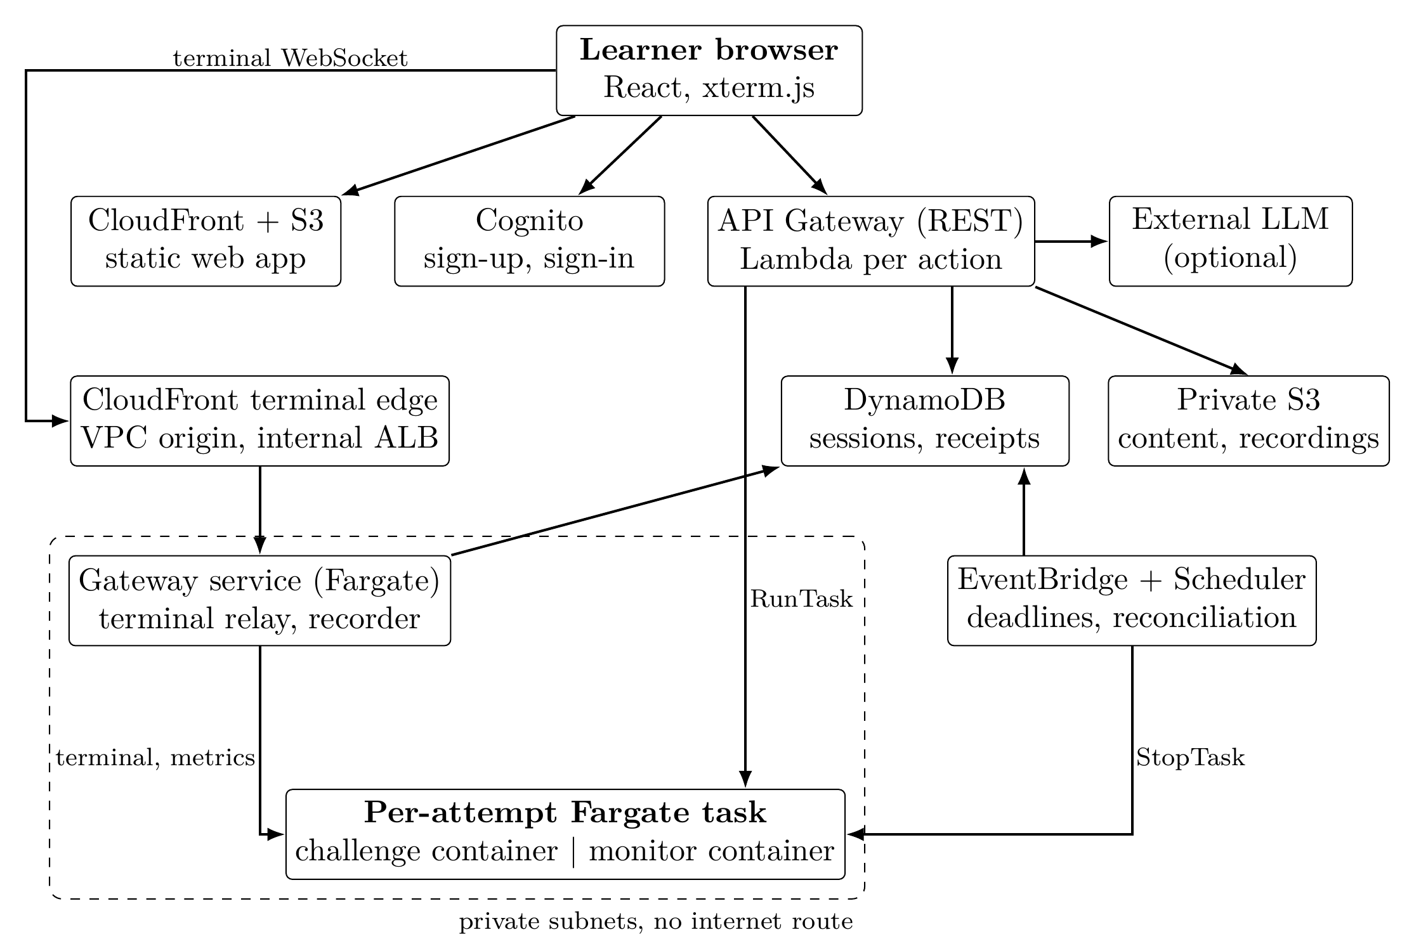
Appendix / AWS architecture
One task per attempt
The challenge and monitor run together. The Gateway controls terminal access and records the session.
Final report, Figure 2, page 5
Notes:
The figure is reproduced from the final report on the docs/final-report branch, Figure 2 on PDF page 5. On the terminal path, CloudFront forwards through a VPC origin and internal load balancer to the Gateway. API and lifecycle handlers ask ECS to start and stop a task. Only the Gateway connects to the attempt task. The deployment shown was used for hosted tests.
Source: https://github.com/ehz0ah/OpsReplay/blob/2cd24a5cb9b2766fe72160646f3e5fe628bb0cfb/docs/reports/final/Final.pdf#page=5
Commit 2cd24a5cb9b2766fe72160646f3e5fe628bb0cfb

